Slide 1

Edmonton Neighbourhood Selection
Adam Asquini
IBM Data Science Professional Certificate

Slide 2
Agenda
Introduction
Business Problem
Data
Methodology
Results
Discussion
Conclusion / Key Takeaways

Slide 3
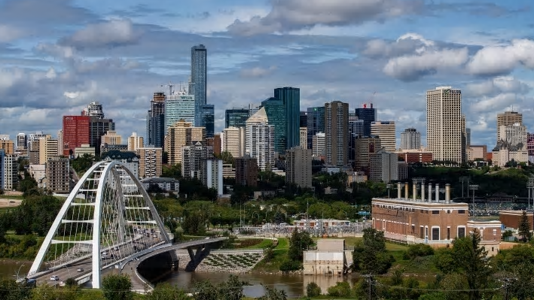
Edmonton
1.3M metropolitan population
Major economic centre for oil and gas industry in Alberta
19,000 real estate transactions per yar

Slide 4
Business Problem
400 Neighbourhoods in Edmonton
Real Estate Transactions often measure in the hundreds of thousands of dollars (or more)
Getting it right the first time is critical
High potential for bias from family, friends and unfortunately sometimes real estate professionals
Need an data-driven approach to compare neighbourhoods that can be mapped to customer needs.

Slide 5
Data Used in This Analysis
Data Source (hyperlinked) | Description
City of Edmonton Open Data Portal – City of Edmonton Neighbourhoods | List of all neighbourhoods and their respective neighbourhood id in the city of Edmonton. This list forms the basis for comparison across neighbourhoods.
City of Edmonton Open Data Portal – Neighbourhood (Centroid Point) | List of the latitude and longitude of the centre point (centroids) of each Edmonton neighbourhood. Used as a coordinate point to determine nearby amenities.
City of Edmonton Open Data Portal – Property Assessment Data (Current Calendar Year) | Property Assessment values for all homes in the city of Edmonton. The average assessed values of homes in each respective neighbourhood will be used as a comparator.
City of Edmonton Open Data Portal – Edmonton Police Service Neighbourhood Criminal Occurrences | Statistics on crime reported to the Edmonton Police Service by neighbourhood in Edmonton in the year 2009 – 2019. Aggregate crime rates by neighbourhood will be calculated as an indicator of the level of crime in the respective neighbourhood
City of Edmonton Open Data Portal – 2016 Census Population by Household Income (Neighbourhood / Ward) | List of the number of people belonging to each income bracket in each neighbourhood in the city of Edmonton. Used to determine the average household income in each neighbourhood.
City of Edmonton Open Data Portal – 2016 Census - Population by Age (Neighbourhood / Ward) | List of the number of people belonging to each age bracket in each neighbourhood in the city of Edmonton. Used to determine the average age in each neighbourhood.
City of Edmonton Open Data Portal – 2016 Census – Population by Structure Type (Neighbourhood/Ward) | List of the number of each home type (single-family dwelling, apartment etc..) in each neighbourhood in the city of Edmonton. Used to determine the rates of each structure type in each neighbourhood.
Foursquare location data (No hyperlink available. Data pulled through Foursquare API) | List of nearby (within 500 metres) venues from each neighbourhood centroid.

Slide 6
Methodology
Import data from City of Edmonton and Foursquare
Data Exploration and Preparation (see slide 7)
Merge data into one master dataframe
Normalize data so all values fit between 0 and 1
Cluster neighbourhoods using K-Means Neighbours from SKLearn package in Python (see slide 8)
Plot results using Folium package in Python
Interpret Results

Slide 7
Data Exploration and Preparation
Data Set | Data Exploration and Preparation
Neighbourhoods | No data wrangling required. The shape of this dataset was 400 rows by 2 columns, meaning there are 400 neighbourhoods in Edmonton
Neighbourhood Centroids | No data wrangling required. The shape of this dataset was 400 rows by 2 columns, meaning there was centroid data (latitude and longitude) for all 400 neighbourhoods in Edmonton
Property Assessment Values | All commercial and residential properties were included. Originally the dataset contained 406,406 rows and 12 columns. One row was removed for having no values. I also removed all commercial properties from the dataset. Finally I grouped the dataset by neighbourhood. Of the 400 neighbourhoods in Edmonton, only 352 had residential properties.
Criminal Occurrences | All criminal occurrences from 2009 to 2019 were included. Resulting in a dataset of 113,077 rows and six columns. I decided to keep the crime data from 2019 only for this analysis and group the dataset by neighbourhood. Once grouped, I was able to determine that 376 of the 400 rows had criminal occurrences in 2019.
Population by Household Income | This dataset was already aggregated by neighbourhood. It had 388 neighbourhoods analyzed. The total number of households within income brackets such as $0-<$30,000, $30,000-$60,000 etc.. were provided.
Population by Age | Similar to the Population by Household Income Dataset, this dataset was already aggregated by neighbourhood.
Population by Housing Structure Type | Similar to the Population by Household Income Dataset, this dataset was already aggregated by neighbourhood.
Foursquare Venue Data | The location of venues within 2km (2,000 metres) was collected by calling the foursquare explore venues API for each neighbourhood. 11,521 records were identified through this call to the Foursquare API.. After collecting the 11,521 records, the dataset was sliced to only include venues that are traditionally seen as desirable for real estate. The types of venues included were: Bank, Café, Gas Station, Grocery Store, Gym, Gym / Fitness Center, Library, Playground, Pool, Recreation Center, School, Supermarket.

Slide 8
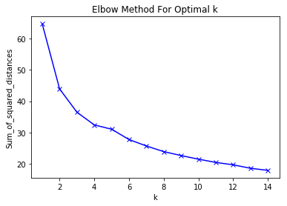
Determining the Optimal K Value
The sum of squared distances error was calculated and plotted for each K from 1 to 15
Using the elbow method, a K value of 5 was use for this analysis

Slide 9
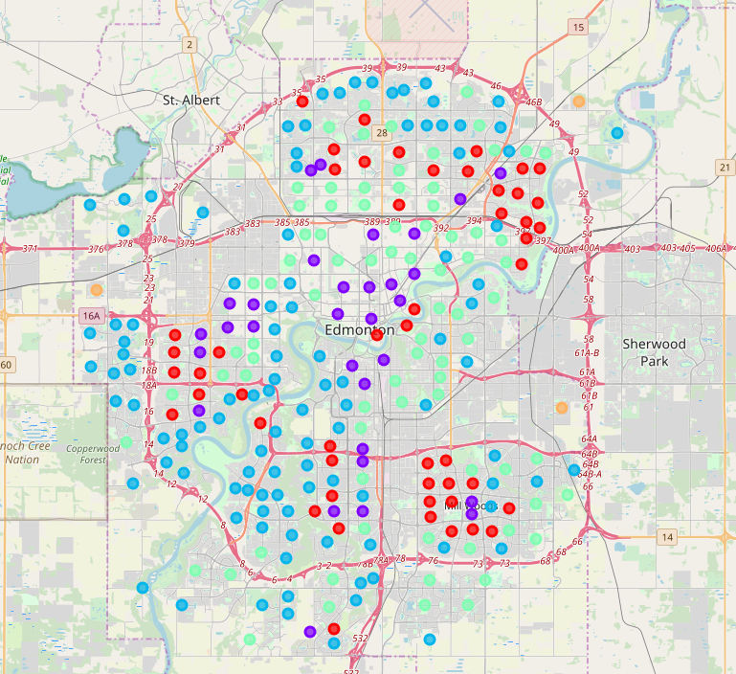
Results
Cluster | Cluster Size | Avg Assessment Value | Avg Criminal Occurrences / Neighbourhood | Income | Age Distribution | Structure | Venue / Amenities
Red | 51 | $282K – 3rd | 30 – 3rd | 68% between $0-$100K | Results similar in all clusters. However, cluster 2 has more 20-30 year-olds than the other clusters. | 43% single detached house | Highest # of recreation and supermarkets
Purple | 31 | $188K – 4th | 48 – 1st | 79% between $0-$100K |  | 20% single detached house | 4-5 times more cafes than other clusters
Blue | 106 | $468K – 1st | 16 – 5th | 42% between $0-$100K |  | 84% single detached house | Highest number of playgrounds 2nd lowest $ of amenities
Green | 79 | $303 – 2nd | 36 – 4th | 65% between $0-$100K |  | 67% single detached house | 2nd Highest # of recreation centres and supermarkets
Orange | 3 | $51K – 5th | 20 – 2nd | 85% between $0-$100K |  | 0% single detached house 99.8% mobile home | Gas station only noted amenity
269 neighbourhoods were clustered and mapped Jupyter Notebook with full results

Slide 10
Discussion
Cluster | Locations Observed | Description of Cluster | Recommended Target Customer
0 Red | Dispersed, but 3 pockets of neighbourhood observed in the NE, W and SE | Mix of single detached homes, row houses and low-rise condos. The cluster has moderate crime levels and a diverse spread of incomes and age brackets. This cluster has the most recreation centres and super markets. Many of the neighbourhoods are mature in this area. | First time home-buyers, families with modest income looking for a single family home, townhouse or condo.
1 Purple | Mostly inner city with small pockets in the W and SE | This cluster hosts most of the downtown neighbourhoods. There is a high number of condos & apartments. Crime is higher in this cluster. However, this may be expected with a cluster hosting many downtown neighbourhoods. The cluster offers the most entertainment and amenity options. | Single adults or couples without kids. Anyone looking for a downtown / urban experience. This cluster may also be attractive for investors looking to rent apartments to business people or students.
2 Blue | Dispersed throughout the perimeter of the N, NW, W and SW portions of the city | Mainly suburban neighbourhoods, many of which are newer explaining their locations closer to the perimeter of the city. This cluster has the highest average household income, highest percentage of single family homes, highest average property assessment value and lowest crime rates | Families looking to expand into a larger home. May also cater to individuals or family that work away from downtown and are not affected as much by commutes into downtown for work.
3 Green | Dispersed further towards the centre or the N, NW, W and SW portions of the city | Mainly suburban, mature neighbourhoods. This cluster is made up of neighbourhoods with predominantly single detached homes and low-rise condos. Like cluster 0, there are lots of family amenities close by in these neighbourhoods. | First time home-buyers, families with modest income, but are more interested in a single family home. Also may be an option for seniors given the proximity of neighbourhoods to services and transportation. May be an option for a customer that does not want to drive given the relative proximity to downtown.
4 Orange | Dispersed on the perimeter in rural areas | This is a small cluster of mobile homes. | Any customer interested in living in a mobile home.

Slide 11
Conclusion
Analysis yielded a good tool for buyers, sellers and real estate professionals to understand characteristics of their neighbourhood, how the neighbourhood compare to others within their cluster and how their cluster varies from other clusters
Analysis needs to be validated with other clustering techniques & more data sets

